Slide 1
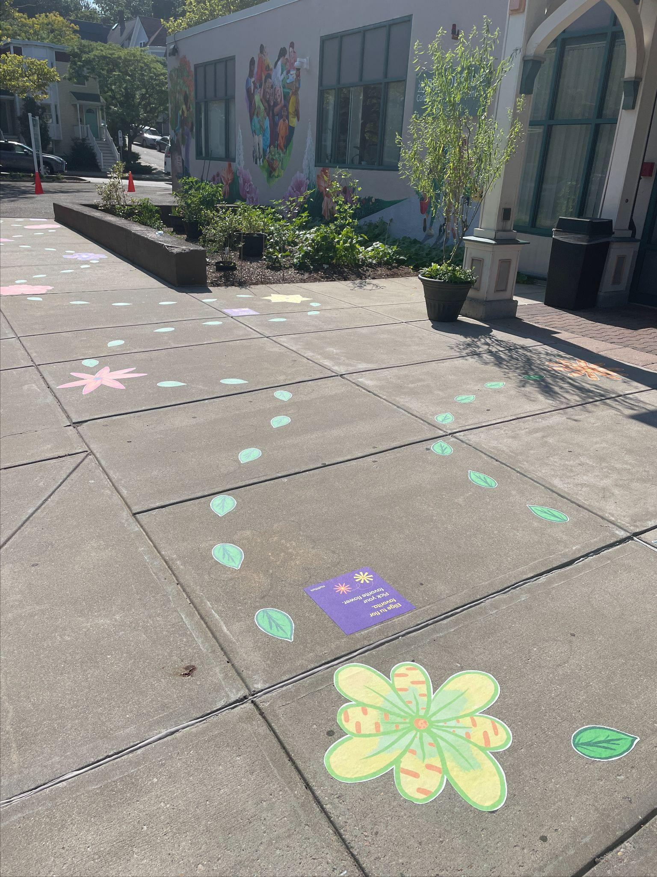
Playful Early Math
in
Pediatric Clinics

Slide 2
Why build playful early math into your clinic?
You provide a trusted and safe space where families spend time together.
TRUSTED SPACE
WAIT TIME

Slide 3
Why build playful early math into your clinic?
Playful early math is fun…and builds math skills!
“...the kids got really excited when they see the zebra, or when they see the giraffe, or when I take the height, and I tell them you have to count how many balls are you? or how many hands? and they start to count. You know the interaction is not just ‘Oh, I’m here for the checkup’, it’s different now, this is different.”
-Medical Assistant, Brookside Community Health Center

Slide 4
Why build playful early math into your clinic?
Playful early math can help improve aesthetics and practices!
Notes:
Why important

Slide 5
What does our research demonstrate about the installation?
Compared with families who visited the clinic prior to the installation of playful early math activities, families who visited the clinic after we installed playful early math activities were…
10 times more likely to say they had conversations with their care providers about shapes and numbers
3 times more likely to report conversations initiated by their child about the paintings, posters, and signs in the clinic
…and more likely to report that their children talked about numbers and shapes while at the clinic.

Slide 6
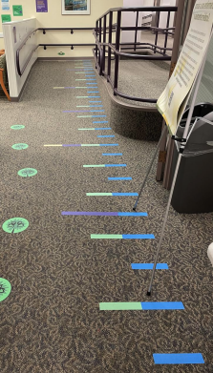
What might an installation consist of?
Notes:
Why important

Slide 7
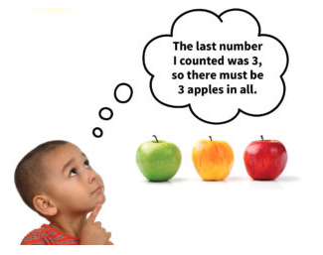
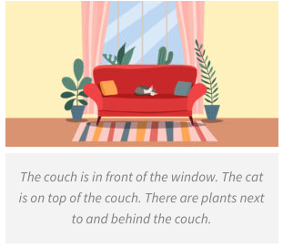
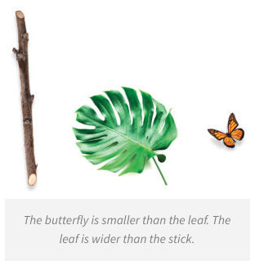
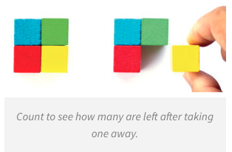
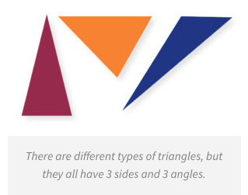
Math concepts that young children can interact with informally:
Spatial Reasoning
Counting
Sorting and Graphing
Measurement
Shapes
Addition/Subtraction

Slide 8
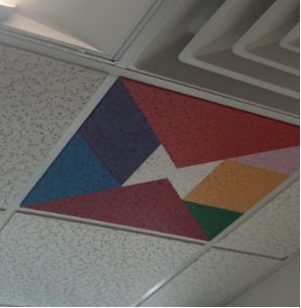
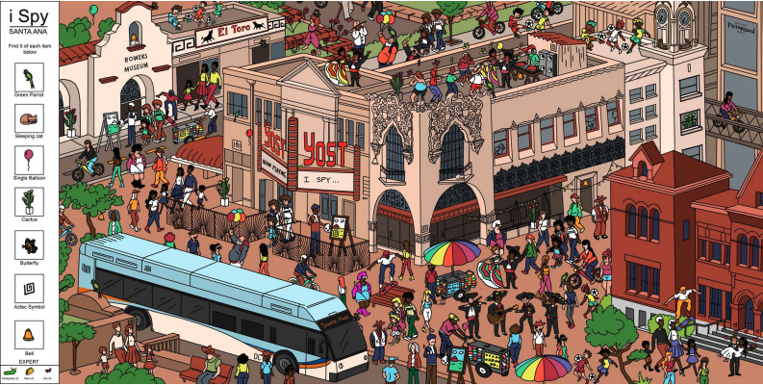
Types of installations that can promote math conversations
I SPY:
Look for shapes and count objects within a mural or wall decoration

Slide 9
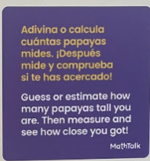
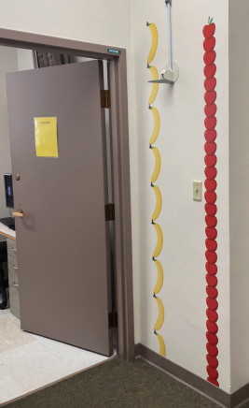
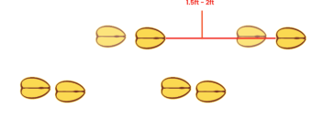
Types of installations that can promote math conversations
LIFE SIZE OBJECTS:
Use the scale of objects to make comparisons and measure height
Fruit on the walls to measure height
Scale footprints on the floor to measure the distance of a step
Notes:
Mechanisms

Slide 10
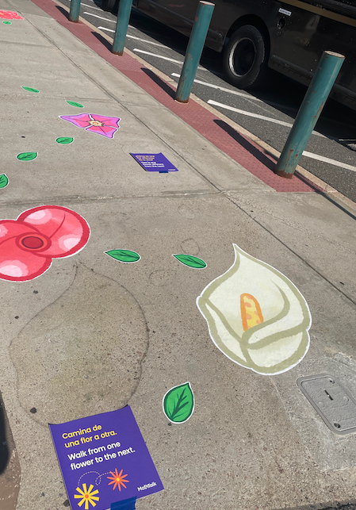
Types of installations that can promote math conversations
MATH TRAILS ON THE FLOOR:
Use the floor to help children understand number lines and counting patterns
Notes:
Mechanisms

Slide 11
Talk prompts in multiple languages help families engage with all types of installations

Slide 12
How do you install playful learning landscapes?
Notes:
Why important

Slide 13
How do you install the design elements on different surfaces?
Ceiling Tiles
On Carpeting
On the Walls
On Sidewalks
Pop out drop ceiling tiles, paint designs on them, and pop them back in
Work with a print shop to print stick-on decals that will adhere to the carpet without peeling up.
Apply decals to the wall, use paint, or tape up laminated print outs. Decals will be more temporary (and can be peeled up and moved).
Apply decals outside (make sure to adhere to dry ground), or use outdoor paint to paint the design on.
1
2
3
4

Slide 14
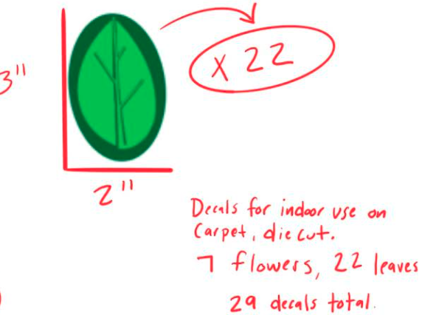
Ordering decals
Create a file with the images you’d like to make into decals in Adobe or Illustrator
Request the sizing, number needed, and the material you will use them on
Send to print shop
Notes:
Why important

Slide 15
Who should be at the table in the design process?
Clinicians
Everyone who participates in an appointment can share ideas about where installations should go to help with wayfinding and spurring conversations, and to give design opinions
Families
Families and children who visit the clinic will tell you what they enjoy and want to interact with
05
01
04
Facilities and Front Desk
These staff members will be able to address materials and upkeep questions, as well as give feedback about where they would and would not want children to be while waiting
Math/Early Learning Experts
Local teachers, partner organizations, or web resources can help you make sure concepts are accurate and age appropriate- they can also help you write talk prompts
02
03
Artists/Designers
Can help design graphics that are colorful and aesthetically pleasing, according to themes, and coordinate with print shop.

Slide 16
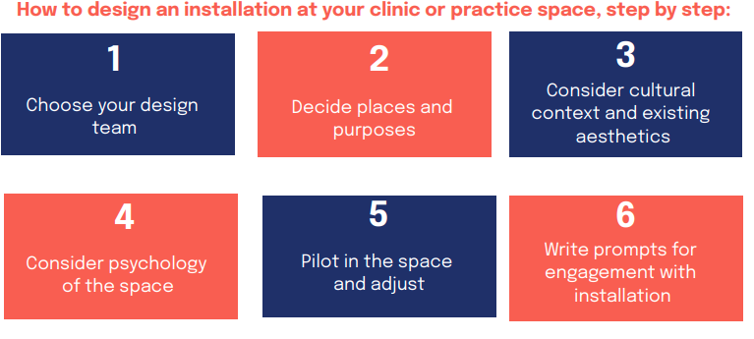
Notes:
Design considerations

Slide 17
Check out our playbook!
Have more questions?
Reach out to us!
eric.dearing@bc.edu, sara.schnitzer@bc.edu
Are you ready to bring playful family math to your clinic?

